Slide 1

Goals and Operation of Operating System
Lecture #4

Slide 2
Goals of Operating System
Following are some of important functions of an operating System.
Memory Management
Processor Management
Device Management
File Management
Security

Slide 3
Memory Management
Keeps tracks of primary memory i.e. what part of it are in use by whom, what part are not in use.
In multiprogramming, OS decides which process will get memory when and how much.
Allocates the memory when the process requests it to do so.
De-allocates the memory when the process no longer needs it or has been terminated.

Slide 4
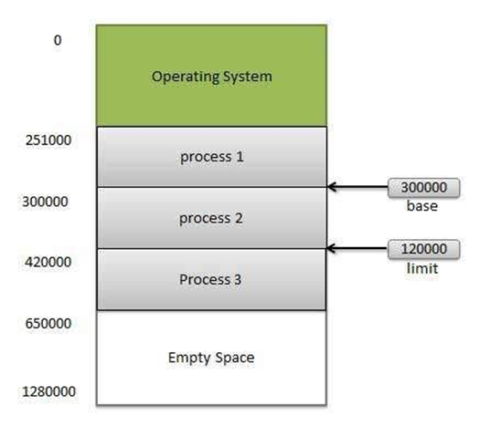
Memory Management

Slide 5
Processor Management
Keeps tracks of processor and status of process. Program responsible for this task is known as traffic controller.
Allocates the processor(CPU) to a process.
De-allocates processor when processor is no longer required.

Slide 6
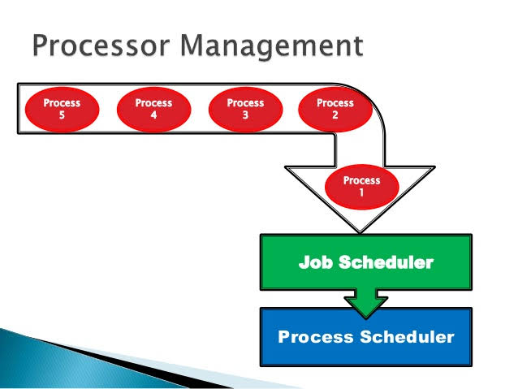
Processor Management

Slide 7
Device Management
Keeps tracks of all devices. Program responsible for this task is known as the I/O controller.
Decides which process gets the device when and for how much time.
Allocates the device in the efficient way.
De-allocates devices.

Slide 8
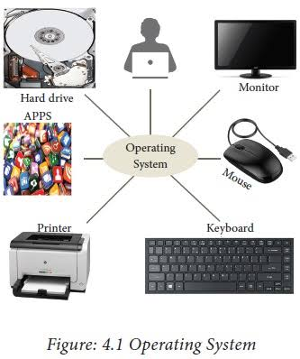
Device Management

Slide 9

File Management
Keeps track of information, location, uses, status etc. The collective facilities are often known as file system.
Decides who gets the resources.
Allocates the resources.
De-allocates the resources.

Slide 10
Other Important Activities
Security -- By means of password and similar other techniques, preventing unauthorized access to programs and data.
Control over system performance -- Recording delays between request for a service and response from the system.
Job accounting -- Keeping track of time and resources used by various jobs and users.

Slide 11
Error detecting aids -- Production of dumps, traces, error messages and other debugging and error detecting aids.
Coordination between other software and users -- Coordination and assignment of compilers, interpreters, assemblers and other software to the various users of the computer systems.

